Slide 1
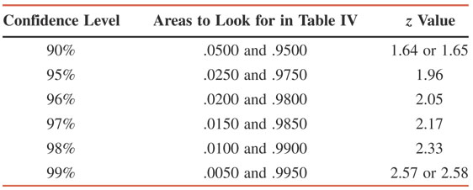
Table 8.1 z Values for Commonly Used Confidence Levels
Prem Mann, Introductory Statistics, 7/E Copyright © 2010 John Wiley & Sons. All right reserved

